Slide 1
MVC Models & the Entity Framework
David Turton
Conestoga College
Institute of Technology and Advanced Learning
www.conestogac.on.ca/~dturton
Doon 2A605 x3610

Slide 2
What's a "Model" in MVC sense?
Physically, it's a class, a description of an object
Used to retrieve & send information to a database
Used to pass data to business processes
Used to convey data to a view from a controller
Used by a controller to pull data from a web page
Used to validate properties of an object
Abstractly, it describes the state of something at a point in time.
It's the Design Class Model, implemented
… and more

Slide 3
A Typical Model
using System;
using System.Collections.Generic;
using System.ComponentModel.DataAnnotations;
namespace MvcMusicStoreCore.Models
{
public partial class Album
{
public Album()
{
Cart = new HashSet<Cart>();
OrderDetail = new HashSet<OrderDetail>();
}
public int AlbumId { get; set; }
public int GenreId { get; set; }
public int ArtistId { get; set; }
public string Title { get; set; }
public float Price { get; set; }
public string AlbumArtUrl { get; set; }
public virtual ICollection<Cart> Cart { get; set; }
public virtual ICollection<OrderDetail> OrderDetail { get; set; }
public virtual Artist Artist { get; set; }
public virtual Genre Genre { get; set; }
}
}
Properties are "real" …
Physically in the object
Relations are virtual …
Entity Framework does not load these by default
But can provide them when requested

Slide 4
Model breakdown
namespace MvcMusicStoreCore.Models
Says Class is logically in "Models" folder of project
It doesn't have to physically be there…
Just as long as the namespace declaration says it is
MVC is built on "convention"
This is where it'll look for models by default
public partial class Album
This declares and names the class
"public" so it is accessible outside of this project
Other programs (& projects) can use it
"partial" so we can apply annotations
Without touching the generated model

Slide 5
Properties of a Model
public int AlbumId { get; set; }
public … so accessible to other programs
int … the property's DataType
AlbumId … name of this property
Note: because this property is
(a) named the same as the class and
(b) has ID suffix (upper, lower or mixed case)
Razor assumes it's the auto-incrementing primary key for the table

Slide 6
Properties of a Model (cont'd)
{ get; set; }
Programs can get (read) and set (change) the value in this property.
aka accessor & mutator … or getter & setter
The ";" is code that runs when getting or setting
Can expand this for edits, metric/imperial conversion, etc.
public virtual Artist Artist { get; set; }
This describes a relationship to a single artist object
It's called a navigational property
public int ArtistId { get; set; }
This property is a foreign key reference to a related table
It may not be evident to you …
Entity Framework will figure it out if you ask for an album's artist's name

Slide 7
Properties of a Model (cont'd)
public virtual ICollection<Cart> Cart { get; set; }
public virtual ICollection<OrderDetail> OrderDetail { get; set; }
These describe zero-to-many relationships to other models
An album can be in multiple shopping carts
Hence the collection of cart objects
An album could be in multiple orderDetail records
Hence the collection of orderDetail objects

Slide 8
Two other Models we'll need data-first approach → generated models
public partial class Genre
{
public Genre() { Album = new HashSet<Album>(); }
public int GenreId { get; set; }
public string Name { get; set; }
public string Description { get; set; }
public virtual ICollection<Album> Album { get; set; }
}
Anyone hazard a guess why these are here?
public partial class Artist
{
public Artist() { Album = new HashSet<Album>(); }
public int ArtistId { get; set; }
public string Name { get; set; }
public virtual ICollection<Album> Album { get; set; }
}

Slide 9
Aside: generating Models from an exiting database
Also known as the Data-First Approach

Slide 10
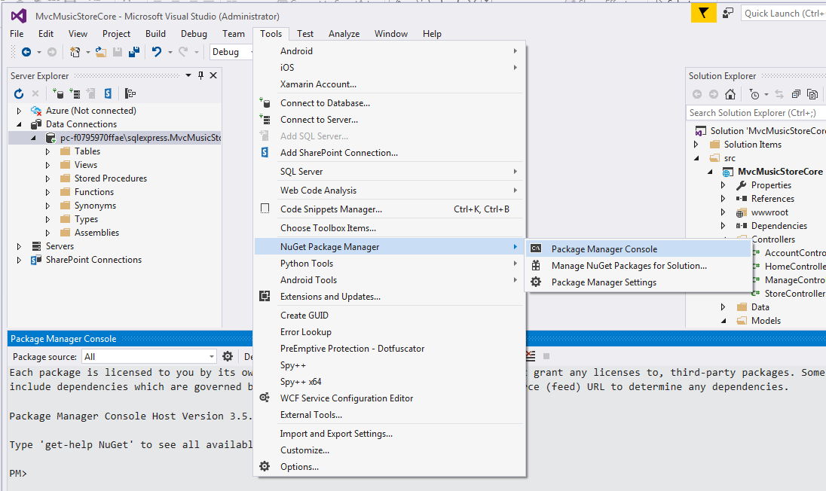
Generating Models - connect to the database - start NuGet Package Manager Console

Slide 11
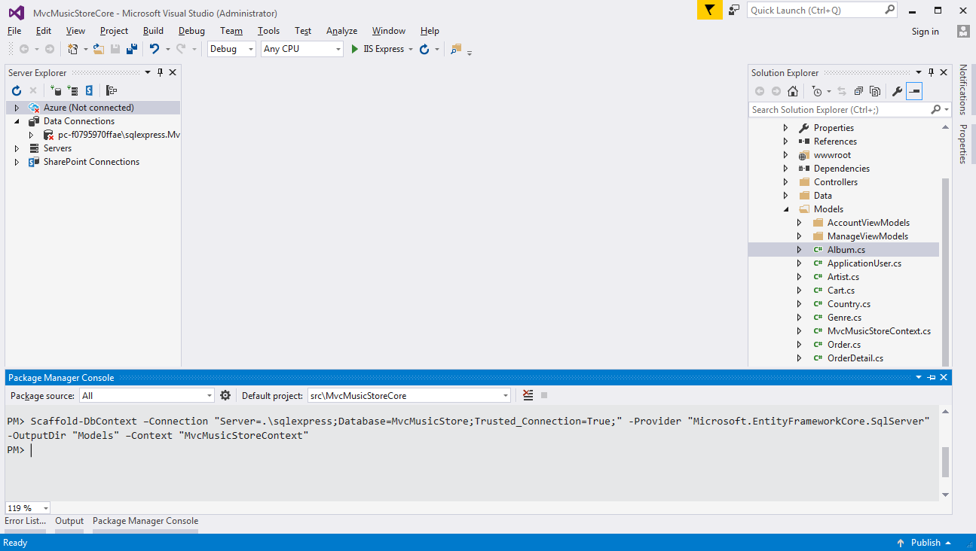
Scaffold (generate) the context & models
I'm using the .\sqlexpress instance of SQL Server here, and placing the models & context into the Models folder
Clipboard copy of command:
Scaffold-DbContext –Connection "Server=.\sqlexpress;Database=MvcMusicStore;Trusted_Connection=True;" -Provider "Microsoft.EntityFrameworkCore.SqlServer" -OutputDir "Models" –Context "MvcMusicStoreContext"

Slide 12
Set up support for Dependency Injection
Add a constructor into the context
Remove or comment-out the OnConfiguring(…) method
Centralise the connection string in appsettings.json
Register the context as a service with Startup.cs

Slide 13
Modify the context to support Dependency Injection
using System;
using Microsoft.EntityFrameworkCore;
using Microsoft.EntityFrameworkCore.Metadata;
namespace MvcMusicStoreCore.Models
{
public partial class MvcMusicStoreContext : DbContext
{
protected override void OnConfiguring(DbContextOptionsBuilder optionsBuilder) {…}
public MvcMusicStoreContext(DbContextOptions<MvcMusicStoreContext> options)
:base(options)
{ }
protected override void OnModelCreating(ModelBuilder modelBuilder) {…}
public virtual DbSet<Album> Album { get; set; }
public virtual DbSet<Artist> Artist { get; set; }
public virtual DbSet<Cart> Cart { get; set; }
public virtual DbSet<Country> Country { get; set; }
public virtual DbSet<Genre> Genre { get; set; }
public virtual DbSet<Order> Order { get; set; }
public virtual DbSet<OrderDetail> OrderDetail { get; set; }
public virtual DbSet<Province> Province { get; set; }
}
}
Remove OnConfiguring method
Add constructor with initialization parameters

Slide 14
Centralise connection string in appsettings.json
{
"ApplicationInsights": {
"InstrumentationKey": ""
},
"ConnectionStrings": {
"MvcMusicStoreConnection":
"Server=.\\sqlexpress;Database=MvcMusicStore;Trusted_Connection=True;MultipleActiveResultSets=true",
"DefaultConnection": "Server=(localdb)\\mssqllocaldb;Database=aspnet-MvcMusicStoreCore-9b41…"
},
"Logging": {
"IncludeScopes": false,
"LogLevel": {
"Default": "Debug",
"System": "Information",
"Microsoft": "Information"
}
}
}
Double-up "\" so it realises it's just a character
… this is JSON, so @"…" doesn't work like C#
Notice the provided example
… remember the comma between the two

Slide 15
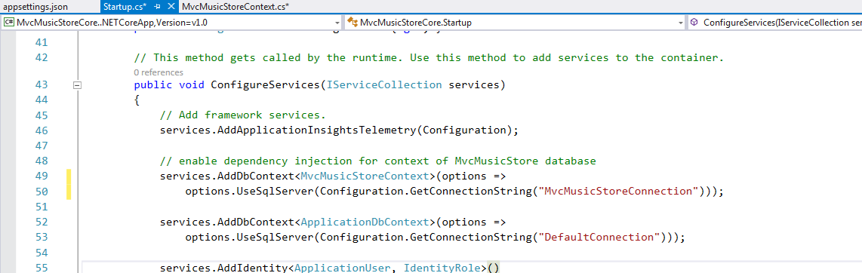
Register the context as a service with Startup.cs
Notice provided example

Slide 16
Build the project before generating Controllers
When you reference your models
It uses the model class in your project .dll
.dll – dynamic link library resulting from the build (compile)
You'll see why, when we do validation … gist is:
If there is another partial class
With the same name & same namespace
Then the two will be combined in the .dll as a single class
It is this aggregate class that we want to use.

Slide 17
End Aside on Generating Models

Slide 18
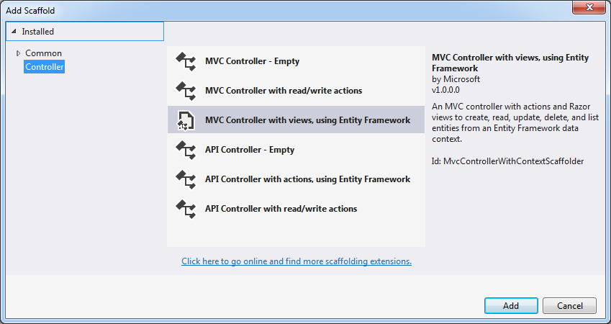
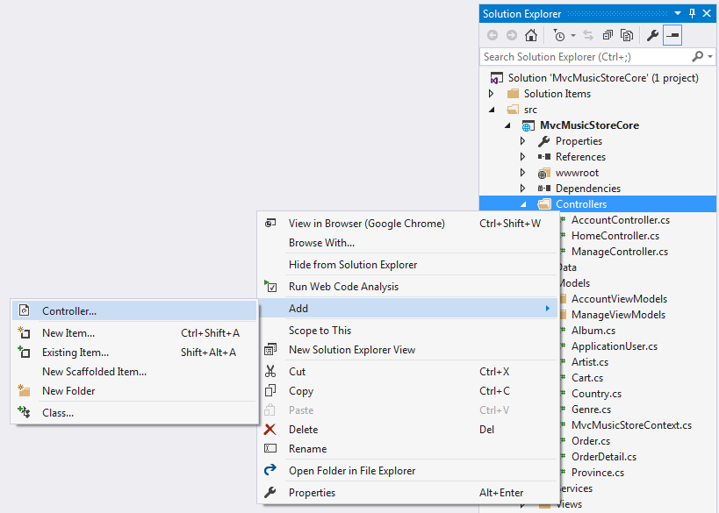
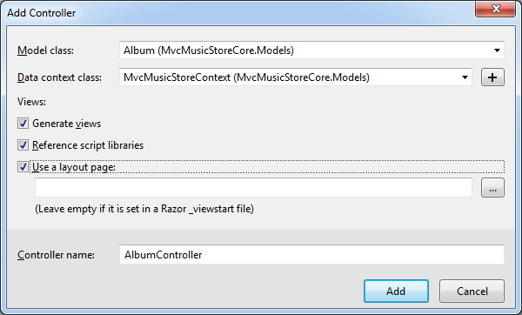
Generate the AlbumController

Slide 19
Scaffolding for a Controller
Controller with read/write actions & views, using Entity Framework
Functional create-retrieve-update-delete (CRUD) actions
Generates all required views
Generates all code to persist & retrieve information from the database
Includes script libraries for validation code (Create & Edit)
You don't need to use it, but it saves time
You can fine-tune the results later
This needs a data model and a data context object
In code-first approach, it can generate the context

Slide 20
Scaffolding for a Controller (cont'd)
Empty controller
Creates the controller with just an empty Index action.
It does not create any views
Controller with read/write actions
Actions don't have any functional code
You could use your own data-access layer classes/repositories
Using Entity Framework or SQL and ADO.NET objects
You can write or generate the views

Slide 21
Database Context (DbContext class)
using System;
using Microsoft.EntityFrameworkCore;
using Microsoft.EntityFrameworkCore.Metadata;
namespace MvcMusicStoreCore.Models
{
public partial class MvcMusicStoreContext : DbContext
{
public MvcMusicStoreContext(DbContextOptions options)
:base(options)
{ }
protected override void OnModelCreating(ModelBuilder modelBuilder) { … }
public virtual DbSet<Album> Album { get; set; }
public virtual DbSet<Artist> Artist { get; set; }
public virtual DbSet<Cart> Cart { get; set; }
public virtual DbSet<Country> Country { get; set; }
public virtual DbSet<Genre> Genre { get; set; }
public virtual DbSet<Order> Order { get; set; }
public virtual DbSet<OrderDetail> OrderDetail { get; set; }
public virtual DbSet<Province> Province { get; set; }
}
}

Slide 22
DbContext
Is used by Entity Framework
It's an abstract class that describes the database
DbSet properties identify the tables:
public virtual DbSet<Album> Album { get; set; }
Declares a table holding objects of the class Album
A service defined in Startup.cs named the same
Constructs an object of the class
Provides it with its connection string

Slide 23
Note on Properties
public string Title { get; set; }
No keyword "static":
So not a class variable … it's an instance variable
It only exists in an object of the class
This is a "property" of an object instantiated from the album class
It could also be presented as:
A private attribute of the object, plus
A public property to get or set the attribute's value

Slide 24
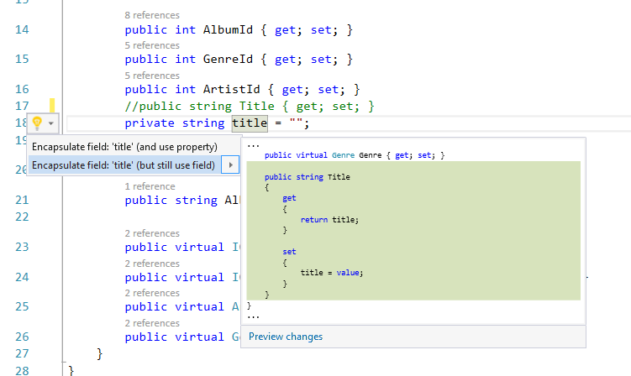
Attribute-&-Property Alternative I like string properties with "" instead of null … and to trim them
private string title = "";
public string Title
{
get
{
return title;
}
set
{
if (value != null) title = value.Trim();
}
}
Separating attribute & property allows you to control what is stored in the attribute
If you store in Imperial measures but accept & return in Metric, you can do data conversions
If you have a get, but no set, the property allows programs to access the attribute value, but not change it

Slide 25
Look at the setup Edit action
The action is passed the selected AlbumId, as "id"
Provides the selected record to the View as ViewData's Model
Provides a list of genres and a list of artists, in ViewData/ViewBag
These will populate the drop-downs
// GET: Album/Edit/5
public async Task<IActionResult> Edit(int? id)
{
if (id == null)
{
return NotFound();
}
var album = await _context.Album.SingleOrDefaultAsync(m => m.AlbumId == id);
if (album == null)
{
return NotFound();
}
ViewData["ArtistId"] = new SelectList(_context.Artist, "ArtistId", "Name", album.ArtistId);
ViewData["GenreId"] = new SelectList(_context.Genre, "GenreId", "GenreId", album.GenreId);
return View(album);
}
Artist drop-down displays name
… Genre displays genreId?

Slide 26
ViewData["GenreId"] = new SelectList( _context.Genre, "GenreId", "Name", album.GenreId);
ViewData["GenreId"] = new SelectList(…
Creates variable named "GenreId" in ViewData/ViewBag
The Album requires "GenreId" … so name this and the
_context.Genres
The database table used to load the SelectList object
"_context" … database context/connection from Dependency Injection
"GenreId"
Name of the Genre source field for the drop-down's selected value
"Name" - changed from "GenreId"
Name of the Genre source field for the drop-down's displayed text
album.GenreId
The genreId currently selected in the retrieved album record

Slide 27
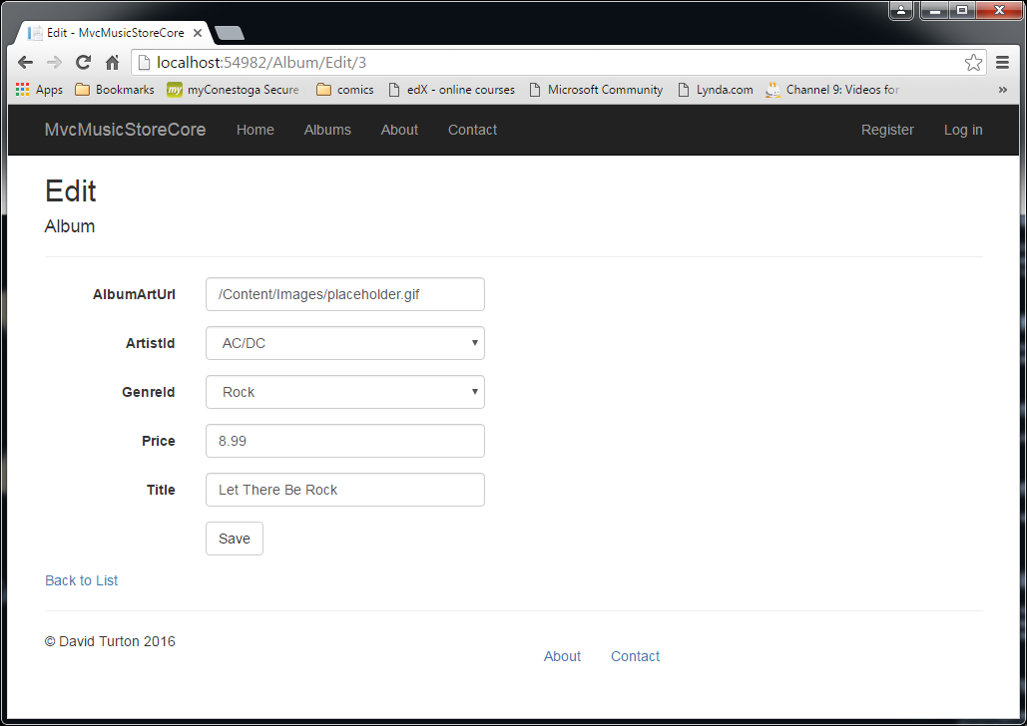
Generated Edit Page for Albums
It understands the album's association to genre and artist
So it creates drop-downs to select them
I suspect "genreId" was being displayed instead of "name" because genre also has "description", an alternate display field … ??
Notice the AlbumId being edited is the 3rd parameter of the URL (id)

Slide 28
Code to create the drop-down (a <select> with <option>s)
The control on the page this label is linked to
<div class="form-group">
<label asp-for="ArtistId" class="control-label col-md-2"></label>
<div class="col-md-10">
<select asp-for="ArtistId" class="form-control" asp-items="ViewBag.ArtistId"></select>
<span asp-validation-for="ArtistId" class="text-danger" />
</div>
</div>
<div class="form-group">
<label asp-for="GenreId" class="control-label col-md-2"></label>
<div class="col-md-10">
<select asp-for="GenreId" class="form-control" asp-items="ViewBag.GenreId"></select>
<span asp-validation-for="GenreId" class="text-danger" />
</div>
</div>
Name of control & name of ViewData source for selection
control name → becomes its post-back name
Display error messages for the field genreId here

Slide 29
HTML code produced
This links to the control with id="genreId", not with the control's name attribute.
… think about radio buttons … all same name!
<div class="form-group">
<label class="control-label col-md-2" for="GenreId">GenreId</label>
<div class="col-md-10">
<select class="form-control" data-val="true" data-val-required="The GenreId field is required."
id="GenreId" name="GenreId">
<option selected="selected" value="1">Rock</option>
<option value="2">Classical</option>
<option value="3">Jazz</option>
<option value="4">Pop</option>
<option value="5">Disco</option>
<option value="6">Latin</option>
<option value="7">Metal</option>
<option value="8">Alternative</option>
<option value="9">Reggae</option>
<option value="10">Blues</option>
</select>
<span class="text-danger field-validation-valid" data-valmsg-for="GenreId" data-valmsg-replace="true" />
</div>
</div>
Drop-down's "name" attribute determines the field-name it will return to the controller

Slide 30
Alternative: a View Model
Generated code uses a model for base data
And ViewBag (aka ViewData) for supplementary data
Can use a view model to pass all the data
… it's a personal-preference thing
There's no performance hit
public class AlbumEditViewModel
{
public Album albumToEdit { get; set; }
public SelectList genres { get; set; }
public SelectList artists { get; set; }
}
Oops… I've introduced a problem: the view is looking for fields called "genreId" and "artistId" … it won't see "genres" or "artists"
…oh … do I have to ask for "albumToEdit.Title" instead of just "Title"?

Slide 31
When the user submits the page
Creates an HTTP POST request to:
/Album/Edit/3 (where 3 is the AlbumId)
Includes data selected or input by the user
Along with the control names
Receiving action is "Edit"
But not the original one …
The Edit preceded with action selector [HttpPost]
Supersedes when action is POST
Will not run for anything else

Slide 32
Post-Back Edit Action
Action Selector … only pages POSTed back from user
[HttpPost]
[ValidateAntiForgeryToken]
public async Task<IActionResult> Edit(int id, [Bind("AlbumId,AlbumArtUrl,ArtistId,GenreId,Price,Title")] Album album)
{
if (id != album.AlbumId)
{
return NotFound();
}
if (ModelState.IsValid)
{
try
{
_context.Update(album);
await _context.SaveChangesAsync();
}
catch (DbUpdateConcurrencyException)
{
if (!AlbumExists(album.AlbumId)) return NotFound();
else throw;
}
return RedirectToAction("Index");
}
ViewData["ArtistId"] = new SelectList(_context.Artist, "ArtistId", "Name", album.ArtistId);
ViewData["GenreId"] = new SelectList(_context.Genre, "GenreId", "GenreId", album.GenreId);
return View(album);
}
The "happy path" … if data is OK, save changes …and return to the index listing
Rudimentary sharp pointy stick stuff
oops
The "sad path" … data not OK … recreate genre and artist lists, return user's input to view

Slide 33
Edit posted back from user happy path
Check ModelState.IsValid property
Did user enter data suitable for album's attributes?
_context.Update(album);
Queues this as an update to an existing record
Puts a lock on the record indicated by the album object
await _context.SaveChangesAsync();
Commit changes: Create & execute an SQL update
"await" releases web server resources while SQL server's working

Slide 34
Edit posted back from user sad path: data errors
Model is not valid
→ Controller needs to re-create the edit view
Can re-populate the controls
User's invalid input is in ModelState
User's valid data is in the Album object
Need the drop-down collections again
ViewData was lost when the page was rendered
Drop-downs were lost on post-back
Only selected values were returned
… how do the error messages appear?
In a process known as model binding

Slide 35
Model Binding
Notice: there's no code like this:
Album album = new Album();
album.Title = Request.Form["title"];
album.Price = Convert.ToDouble(Request.Form.["price"]);
Back to conventions …
The TextBox for title had the name "Title"
The drop-down for genreId had the name "GenreId"
Input names → matched to property names
Model Binder
public async Task<IActionResult> Edit(int id, Album album)
Model binder builds an Album object for you…
And fills its properties with like-named fields from the browser
It also pick up the original id from the URL

Slide 36
Model Binder
Looks at parameters to the controller action
Discovers properties of complex objects (album)
Can handle multiple parameters & primitives
Follows naming convention
Converts & moves values from request into parameters for the action
Album has a parameter named "Title"
Looks for a field named "Title" (any case) in the request
A Lot of data comes in with the request
Route data (URL), query string, form collection, cookies, server variables…
You should know where Binder looks for input & in what sequence

Slide 37
Binder is also used for HTTP GET
public async Task<IActionResult> Edit(int? id)
Will find ID in the URL: /Album/Edit/5
Convention: /controller/action/ID
Or query-string: /Album/Edit?id=5
Or "ID" anywhere on the page, any case
Can't find a like-named value?
Normally, property will be null … not a good number
That's why you look for int? … a nullable integer
Over-posting attack (later)
"Nasties" provide properties you don't expect…
[Bind("AlbumId,AlbumArtUrl,ArtistId,GenreId,Price,Title")] Album album
Bind limits the fields Binder will look for

Slide 38
TryUpdateModelAsync - control when binding happens
public async Task<IActionResult> Edit(int id)
{
Album album = new Album();
if (await TryUpdateModelAsync(album))
{
try
{
_context.Update(album);
await _context.SaveChangesAsync();
TryUpdateModel – invokes Binder when you tell it to
Moves valid fields, flags invalid fields … just like before
If you have computed fields
You can construct them before they're validated

Slide 39
ModelState
Updated whenever binder moves a value into a model
You can check it after binding:
Album album = new Album();
await TryUpdateModelAsync(album);
if (ModelState.IsValid)
If there are errors, Model State will contain:
Names, attempted values and error messages
… for the properties in error
Views use this to help users correct their input
Looks here first to populate controls on the page

